Slide 1

NCDOT - ProjectWise Pilots
October 18, 2018
Dial 919-662-4528
U-5516
R-5600
R-4707
B-4937
B-5356
Div 5
Ben Upshaw
John Braxton
Div 14
Wesley Jamison
Josh Deyton
Central
Laura Sutton
Bryan Key
Structures
Kevin Fischer
Structures
Kevin Fischer

Slide 2
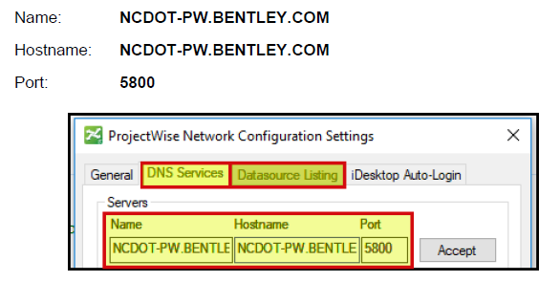
NCDOT ProjectWise Hosted by Bentley

Slide 3
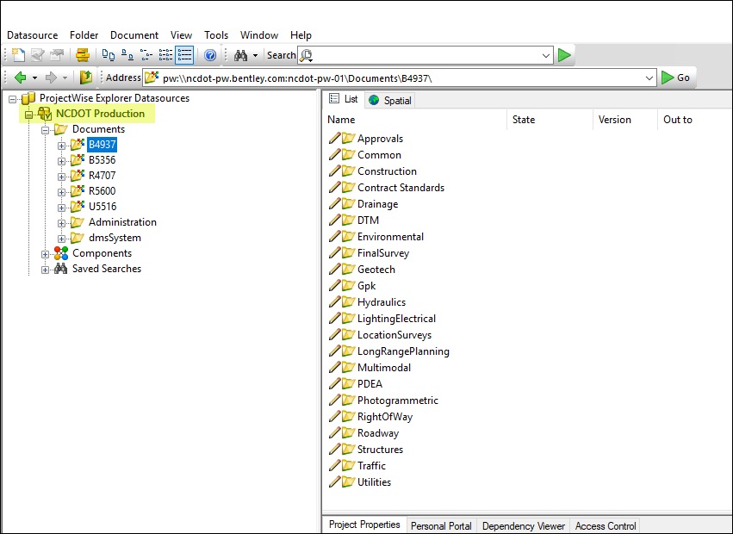
NCDOT ProjectWise Hosted by Bentley

Slide 4
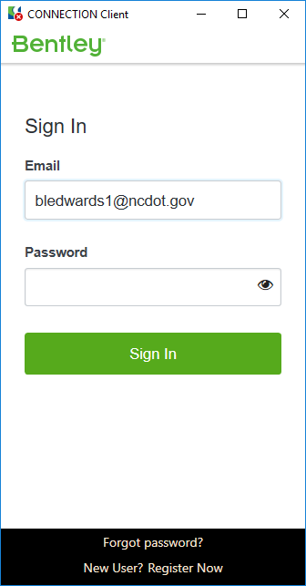
ProjectWise Authentication - Internal
Federated against our Active Directory
Connection Client
Simply enter email address and click tab or enter
ADFS Federation automatically passes Windows AD authentication to Bentley making sign in a breeze!

Slide 5
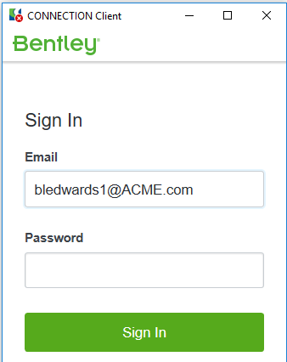
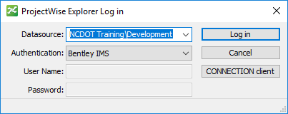

ProjectWise Authentication - External
Bentley IMS
Identity Management System
Identity is checked against the
email domain of your company
(ex. bledwards1@ACME.com)
1
PEF User
Project Access
Write access permission will be established by PW Admin and will be restricted to the Project specific area that PEF is working on
2
Create User Account in ProjectWise
Assign to Group in ProjectWise
NCDOT PW Admin

Slide 6
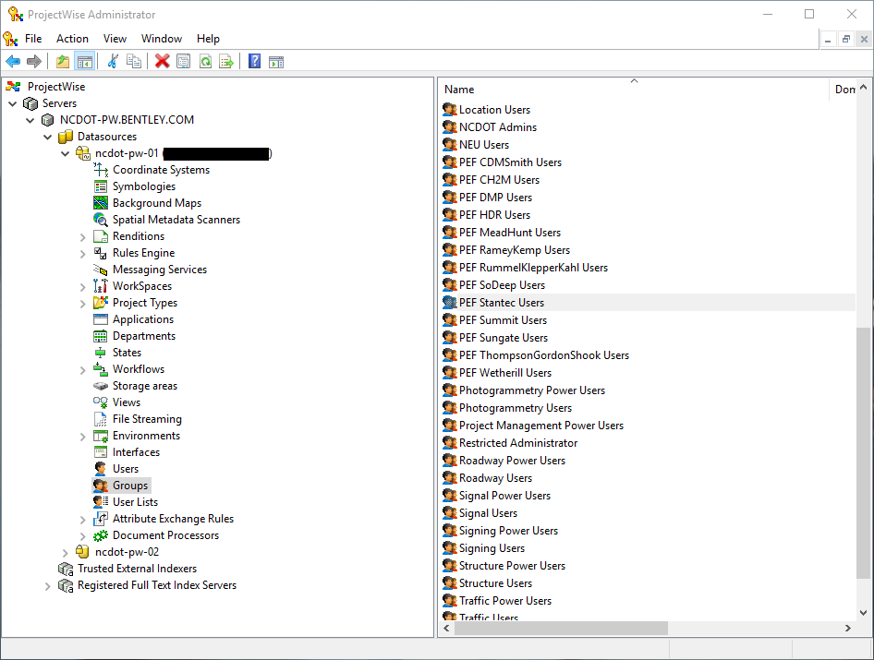
ProjectWise Users/Group
ProjectWise System Admins must create users/groups in ProjectWise in order for them to access ProjectWise
Power Users in Units can manage (add/remove) users from respective groups. (Ex. Mike Kelly can add or remove people from the Hydraulic Users group)
Project Leads can manage PEF Groups access to Projects
PEF Group management – We can authorize representative from PEF to administer users within their respective groups
Explore the idea of mirroring the SharePoint process for consultant AD Groups and access and ownership of group.

Slide 7
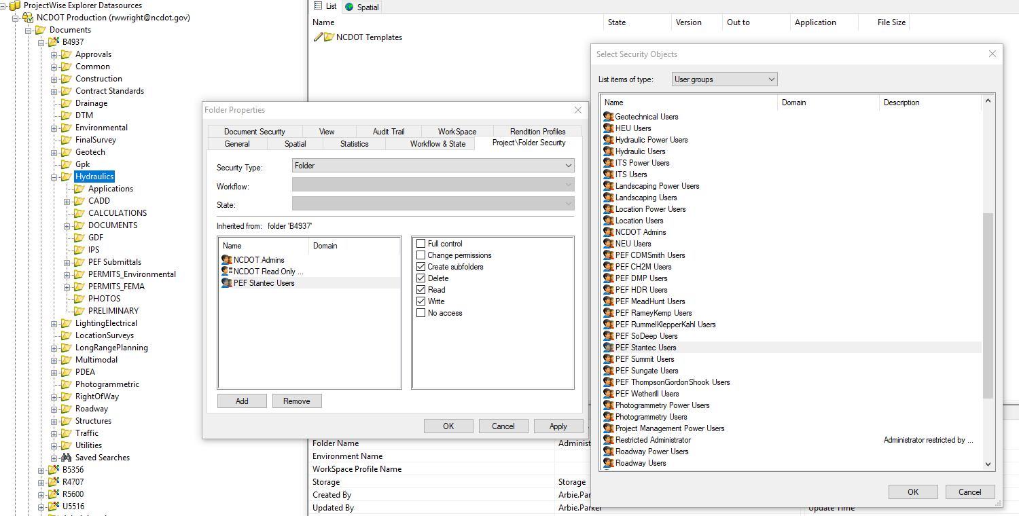
ProjectWise Users/Group Permissions

Slide 8
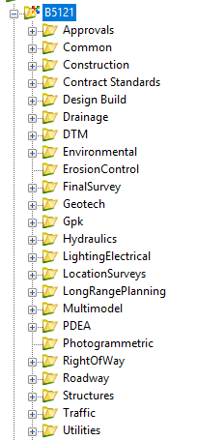
Managed Workspaces (CADD)
Workspaces are built in to ProjectWise
Folder Driven - Any DGN file opened under a Hydraulics folder will open MicroStation in Hydraulics workspace, and so on.
First Time Open – ProjectWise has to download the entire workspace. All subsequent opens pull only workspace deltas
Speed Expectations - Slow on first time open

Slide 9
Selected Pilot Projects
U-5516
R-5600
R-4707
B-4937
B-5356
Div 5
Ben Upshaw
John Braxton
Div 14
Wesley Jamison
Josh Deyton
Central
Laura Sutton
Bryan Key
Structures
Kevin Fischer
Structures
Kevin Fischer

Slide 10

Switchover to ProjectWise
Proposed Switchover Date:
Friday October 26 at COB
ProjectStore
U-5516
R-5600
R-4707
B-4937
B-5356
ProjectWise
U-5516
R-5600
R-4707
B-4937
B-5356
Transfer to PW

Slide 11

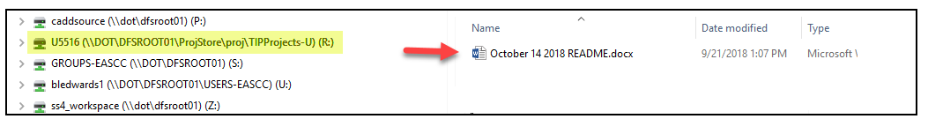
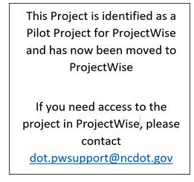
Switchover to ProjectWise
Proposed Switchover Date:
Monday October 29 at COB
Archive
U-5516
R-5600
R-4707
B-4937
B-5356
ProjectStore
U-5516
R-5600
R-4707
B-4937
B-5356

Slide 12
Pilot Readiness
Project Folder Template
Managed Workspaces
User / Groups Created
Deployment of ProjectWise / Connection Client Software to Pilot Users
Documentation / User Training
PEF Communication
  Where/how to download ProjectWise
  Access to NCDOT ProjectWise Datasource

Slide 13
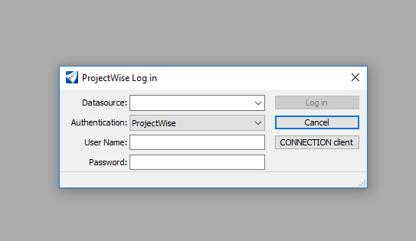
What if I don’t want to go into ProjectWise …

Slide 14
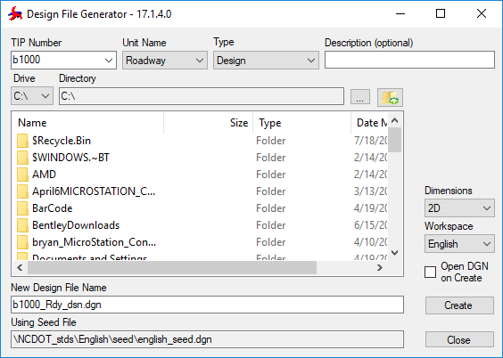
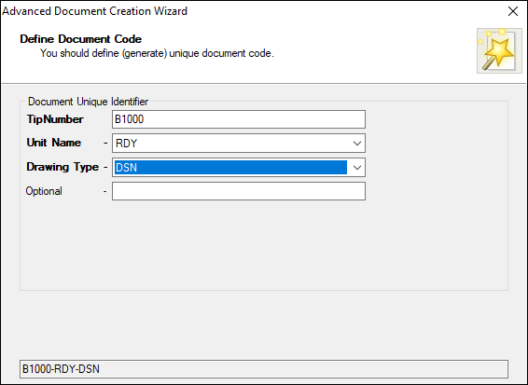
File Generation in PW - No Underscore in Filename
Design File Generator
ProjectWise Advanced Document Creation Wizard
B1000_rdy_dsn.dgn
B1000-rdy-dsn.dgn
ProjectWise can handle files with underscores just fine. However, the file generation capability of ProjectWise can not handle underscores

Slide 15
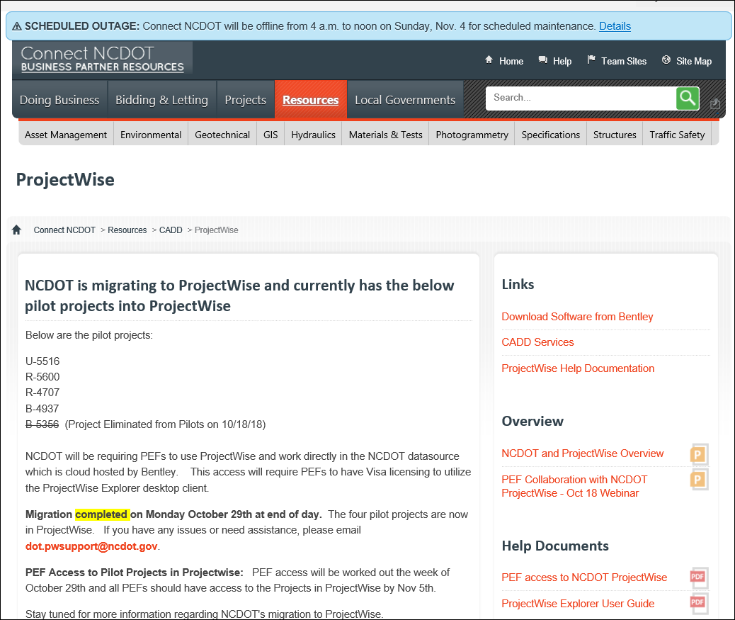
ProjectWise Website
https://connect.ncdot.gov/resources/CADD/Pages/ProjectWise.aspx

Slide 16
NCDOT ProjectWise
If you have issues or questions regarding the pilot projects and ProjectWise, please contact dot.pwsupport@ncdot.gov
Thank You!

Slide 17
What’s Next
SAP Feed / Caching Server
NCDOT
Datasource
Powershell (SAP metadata)
SAP
SharePoint
FTS (SAP metadata)
Caching
Server
Sync Milestone PDFs

Slide 18
Unresolved issues
Firms stance on write access to folders by NCDOT staff
Any harm in pushing ProjectWise out to ALL users?
What else?

